Slide 1



Flowcharts

Slide 2
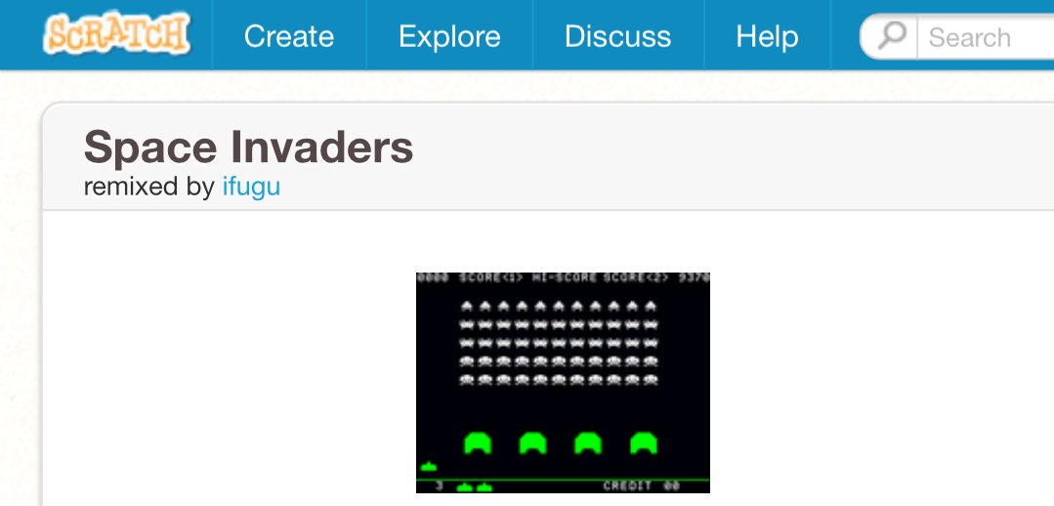
Flowcharts
Go to Google and search for
"Scratch space invaders"
Click on the first link:
http://scratch.mit.edu/projects/1979494/

Slide 3
See what score you can get in five minutes!

Slide 4
All of these
objects are called
sprites

Slide 5
A sprite is another
word for a graphic
(like a player or alien)
in a game

Slide 6
Sprites obey the rules of the game they appear in!

Slide 7
Write down the rules for each of these sprites:
Think about these things:
1. Did the sprite do anything when you pressed a key?
2. What did the sprite do when a bullet hit it?
3. What happened when it reached the edge of the game area?
4. What other rules did they obey?

Slide 8
What rules did you get?
Moves from right to left after a period of time
Explodes when player bullet hits it

Slide 9
Moves left to right
Changes direction when one of the aliens touches the edge of the stage
Fires bullets at random intervals
Explodes when player bullet hits it

Slide 10
Moves left when left arrow pressed
Moves right when right arrow pressed
Fires bullet when space pressed
Explodes when alien bullet hits it

Slide 11
There is an easy way of writing down rules like these...

Slide 12
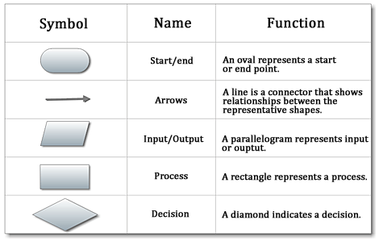
Flowcharts!

Slide 13







Start: move saucer
Start: kill saucer
Example:
Is it saucer time?
Has bullet hit?
No
Yes
No
Yes
Move saucer right to left
Display explosion
Past edge of area?
Stop
No
Yes
Stop

Slide 14
Create flowcharts for:
1. Saucer
2. Aliens
3. Player

